Slide 1
Computer Maintenance
What does “CRT” stand for?

Slide 2
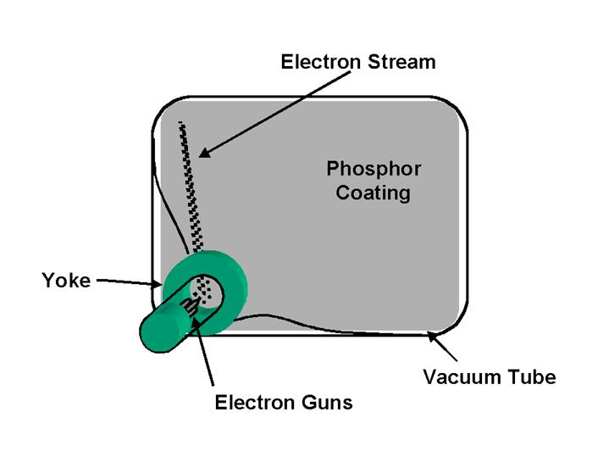
CRT
Cathode ray tube (CRT)
All CRT monitors have a cathode ray tube (CRT), which is a vacuum tube
One end of this tube is a slender cylinder that consists of three electron guns
The wide end of the CRT is the display screen

Slide 3
Warning
Opening up a monitor can be deadly!
Even when the power is disconnected, certain components inside a monitor retain a substantial voltage for an extended period of time. If you accidentally short one of the components, it could actually kill you!

Slide 4
CRT
When power is applied to one or more of the electron guns, a stream of electrons is generated
This stream is subjected to a magnetic field generated by a ring of electromagnets called a yoke
The phosphor coating, when struck by the electron beam, releases energy as visible light
The phospors continue to glow momentarily after being struck – called persistence.

Slide 5
CRT Refresh Rates
Video data is displayed on the monitor as the electron gun sweeps the display horizontally, energizing appropriate areas on the phosphor coating.
Horizontal Refresh Rate (HRR)
The speed at which the electron beam moves across the screen
Vertical Refresh Rate (VRR)
The amount of time taken by the monitor to draw the entire screen and get the electron beam back to the start

Slide 6
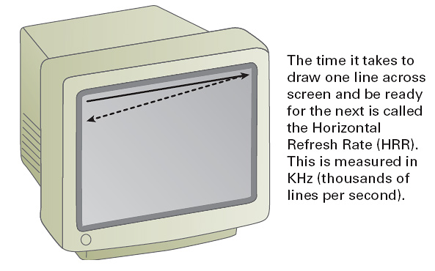
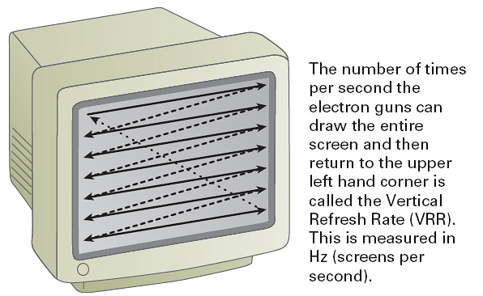
CRT Refresh Rates

Slide 7
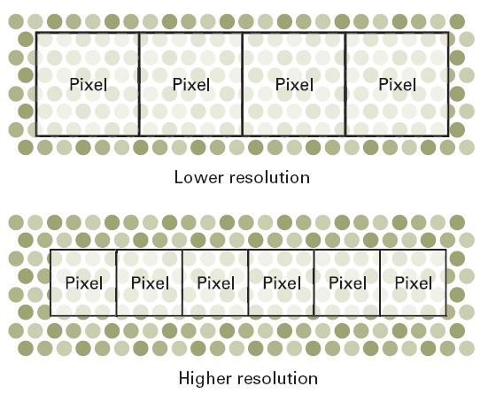
Resolution
Monitor resolution is always shown as the number of horizontal pixels times the number of vertical pixels
Some common resolutions are 640X480, 100X600,1024X768, 1280X1024, and 1600X1200
These resolutions match a 4:3 ratio called the aspect ratio

Slide 8
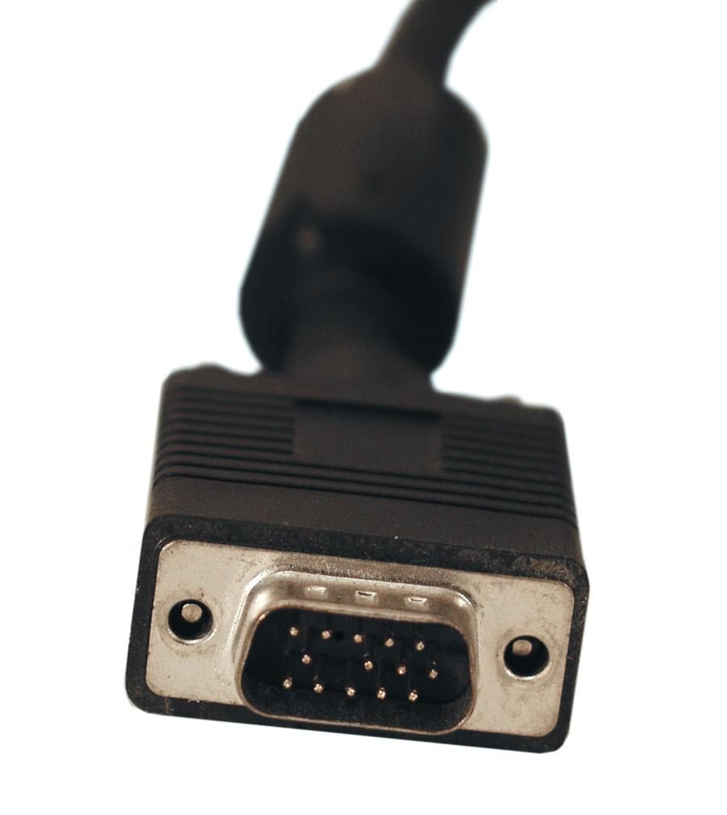
CRT Connections
CRT monitors use a 15-pin, 3 row, DB type connector, and a power plug

Slide 9
Do’s and Don’ts
Do keep the screen clean
Do keep the cables tightened
Do use quality cabling
Do use power management
Do dispose of monitors properly by checking with your local waste disposal company
Don’t block the ventilation slots
Don’t use a refresh rate higher than recommended
Don’t leave the monitor on all the time – even with a screen saver
Don’t place magnetic objects like unshielded speakers close to the monitor

