Slide 1
Computer Maintenance
Introduction to PCs:
How Computers Work
UNT in partnership with TEA, Copyright © . All rights reserved

Slide 2
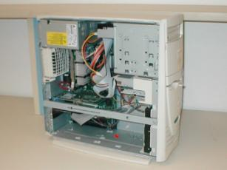
Topics of Discussion
Basic Functions of an Operating System
Bootstrap
Power-On Self Test (POST)
Motherboards
Central Processing Unit
Control Unit
Processor Speed
Expansion Slots

Slide 3
Topics of Discussion (cont.)
Monitors
I/O Ports
Serial Ports
Parallel Ports
PS/2 Ports
EIDE and SCSI Controllers
Hard Disk Drive
Interrupt Request
I/O Address

Slide 4
Basic Functions of an Operating System
Input – Recognizing entries from the keyboard or mouse
Processing – Manipulating data according to the user’s instructions
Output – Sending output to the video screen or printer
Storage – Keeping track of files for use later. Examples of storage devices include floppy disks and hard drives.

Slide 5
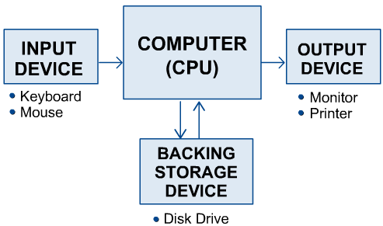
Basic Functions of an Operating System (Cont.)

Slide 6
Bootstrap
For an operating system to run, it must be loaded into the computer’s Random Access Memory (RAM).
When a computer is first turned on, it launches a small program, called the bootstrap loader, that is built into the computer’s hardware.
Specifically, the bootstrap is located on the BIOS chip, which resides on the system board
The bootstrap’s primary functions are to test the computer’s hardware and to locate and load the operating system into RAM

Slide 7
Power-On Self Test (POST)
To test the computer’s hardware, the bootstrap program runs a program called power-on-self-test or POST.
The computer’s CPU checks itself first and then checks the computer’s system timer.
The POST checks the RAM by writing data to each RAM chip and then reading that data (any difference indicates a problem).
If POST finds errors, it sends a message to the computer monitor. If it can’t send to the monitor – it sends “beeps.”
The POST sends one beep, and the screen begins to display OS loading messages, once the computer has determined that the computer has passed the POST.

Slide 8
Motherboards
The motherboard, also called the system board or main board, is the nerve center of the computer system.
Everything else in the system plugs into it, is controlled by it, and depends on it to communicate with other devices on the system.
It houses the CPU, controller circuitry, the bus, RAM, expansion slots for additional boards, and ports for external devices.
In addition, it contains the CMOS, other ROM BIOS, and support chips providing varied functionality.

Slide 9
Motherboards

Slide 10
Motherboard Form Factors
Motherboards are usually described by their form factors which describe their physical dimensions.
The two most common form factors used today are:
Baby AT motherboards
ATX motherboards
The ATX is similar to the Baby AT except for a number of important enhancements.
Most new systems come with the ATX motherboard form factor.

Slide 11
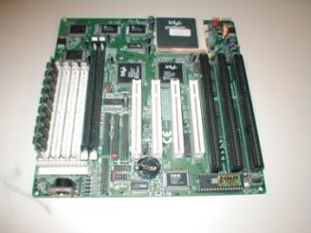
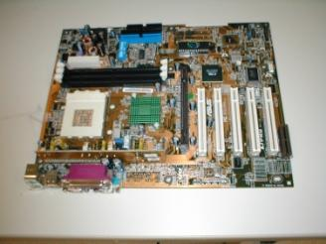
Motherboard Form Factors (Cont.)
AT
ATX

Slide 12
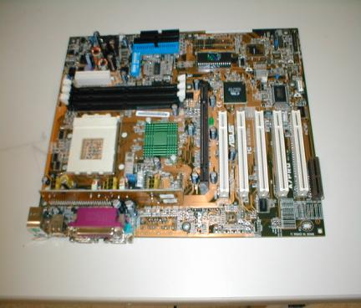
Motherboard Components
Chipset
CPU socket
Expansion sockets
I/O support
BIOS
RAM sockets
Power supply socket
CMOS chip
Dipswitches/jumpers
Memory cache
ATX

Slide 13
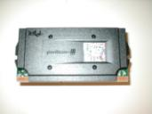
Central Processing Unit
The CPU is one of the most important elements of a personal computer.
On the motherboard, the CPU is contained on a single integrated circuit called the microprocessor.
The computer will not run without a CPU.
Often referred to as the brains of a computer, the CPU contains two basic components:
Control unit
Arithmetic/Logic Unit (ALU)

Slide 14
Control Unit
Instructs the rest of the computer system on how to follow a program’s instructions
It directs the movement of data to and from processor memory.
The control unit temporarily holds data, instructions, and processed information in its arithmetic/logic unit.
In addition, it directs control signals between the CPU and the external devices such as hard disks, main memory, I/O ports, etc.

Slide 15
Processor Speed
CPU descriptions such as Pentium 133, Pentium 166, or Pentium 200 are well known.
These numbers are specifications that indicate the maximum reliable operating speed at which the CPU can execute instructions.
The CPU speed is NOT controlled by the microprocessor itself, but by an external clock located on the motherboard.
The speed of the processor is determined by the frequency of the clock signal.
It is typically expressed in megahertz (MHz), and the higher the number, the faster the processor.

Slide 16
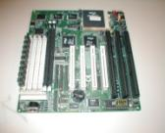
Expansion Slots
Expansion slots (sockets) are receptacles on the motherboard that accept printed circuit boards.
All computers have expansion slots that allow additional devices to be added.
Video cards, I/O cards, and sound cards are examples of components that are located in expansion slots.
The common expansion slots that are likely to be encountered include the following:
Industry Standard Architecture (ISA)
Peripheral Component Interconnect (PCI)
Accelerated Graphics Port (AGP)
PCI is most commonly used on new motherboards
AT

Slide 17
Monitors
Computers are usually connected to a display, also called a monitor.
Some key monitor-related terms are pixels, refresh rate, resolution, and size.
Pixels – picture elements.
the screen image is made of pixels (tiny dots)
which are arranged in rows across the screen
each pixel consists of three colors: red, green, and blue (RGB)
640x480 is the standard VGA resolution.
Dot pitch – A measurement of how close together the phosphor dots are on the screen. The finer the dot pitch, the better the image quality (measured in millimeters).

Slide 18
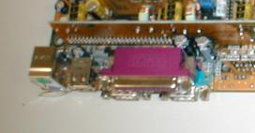
I/O Ports
All peripheral devices that connect to the computer such as printers, scanners, and so on, use a connector on the back of the computer known as a port.
There are different types of ports on the computer that serve different purposes. Some of the common ports are
Serial Ports
Parallel Ports
PS/2 Ports

Slide 19
Serial Ports
A serial port can be used to connect devices that use a serial interface, such as a modem, scanner, mouse, etc.
Generally, a PC can identify up to four serial ports, but the typical computer contains only two, referred to as COM1 and COM2.
A serial port transmits data bits one after the other (serially) over a single line.

Slide 20
Parallel Ports
A parallel port is a socket on the computer that is used to connect a printer or other peripheral device, such as a portable hard disk, tape backup, scanner, or a CD-ROM.
The parallel port contains eight lines for transmitting an entire byte (8 bits) across the eight data lines simultaneously.
Parallel ports can be configured as LPT1, LPT2, or LPT3.

Slide 21
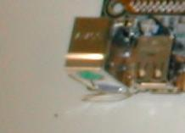
PS/2 Ports
PS/2 keyboard or PS/2 mouse ports are used to connect your PC to its keyboard and mouse.
Though both ports look identical, the mouse (green) and keyboard (purple), the ports are not interchangeable.
Usually both ports are color-coded or labeled to avoid any confusion.

Slide 22
EIDE and SCSI Controllers
The internal hard drive is connected to a disk controller with a cable.
The hard drive and other devices can use one of two types of interface controllers to work with the computer.
Enhanced Integrated Drive Electronics (EIDE).
Small Computer System Interface (SCSI).
Pronounced “scuzzy.”

Slide 23
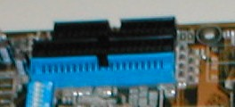
EIDE Controllers
Enhanced IDE (EIDE) is the “new and improved” Integrated Drive Electronics (IDE) drive interface.
Not confined to IDE’s 528 MB of data, the EIDE interface can handle up to 8.4 GB or more.
While IDE can support only two drives, EIDE can support up to four devices using two IDE cables.

Slide 24
SCSI Controllers
The Small Computer Systems Interface (SCSI) controller evolved from the Shugart Associates Standard Interface (SASI).
Like EIDE, SCSI devices have the controlling electronics on each of the drives.
A standard SCSI interface will allow up to seven devices to be connected.
Such devices may include hard drives, CD-ROM drives, taped drives, scanners, and removable drives.
Each SCSI device in the chain is given a SCSI ID number from 0 to 7.
#0 for the primary boot device (hard drive)
#7 for the SCSI controller card

Slide 25
Hard Disk Drive
The HDD has a much larger storage capacity than the floppy for long-term storage.
It stores your programs and files, as well as the operating system.
Typically, the HDD is an internal drive that is not removed from the computer.

Slide 26
Hard Disk Drive Components
All hard disk drives share a common set of components. These components include: disk platters, read/write heads, head actuator assembly, spindle motor, logic/circuit board, configuration jumpers, and interface connectors.
Disk platters are the actual media on which data is stored on the hard disk drive.
Read/write heads are used to access the media. The disk platters require a read/write head for each side.
The spindle motor spins the platters.

Slide 27
Interrupt Request
Modern computers and operating systems owe their reliability to the organized ways in which they handle internal transactions.
Various hardware devices, for example, may want to tell the CPU that they have some information available that is ready for transfer.
The devices indicate this by making an interrupt request, or IRQ.
It is a general rule that IRQs CANNOT be shared.

Slide 28
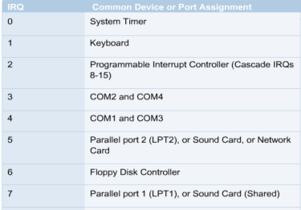
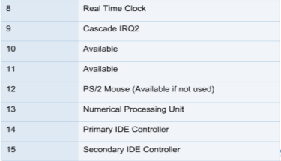
Interrupt Request

Slide 29
Interrupt Request
Direct Memory Access (DMA) channels allow devices to bypass the processor and directly access the computer memory.
Devices with a DMA channel assignment, as a result, gain the advantage of faster data transfers.
DMA channels are typically used by high-speed communications devices for transferring large amounts of data at high speeds.
Examples of such devices include sound cards, some network cards, some SCSI cards, some disk drives, and some tape backup drives.

Slide 30
I/O Address
In addition to an IRQ, computer components also need to be assigned an I/O port number.
An I/O port number is a memory address where data is temporarily stored as it moves in and out of the devices.
The I/O address is very similar to a Post Office box.

Slide 31
I/O Address
Frequently referred to I / O Addresses:
3F8 = COM1
2F8 = COM2
3E8 = COM3
2E8 = COM4
378 = LPT1
278 = LPT2

Slide 32
Summary
Basic Functions of an Operating System
Bootstrap
Power-On Self Test (POST)
Motherboards
Central Processing Unit
Control Unit
Processor Speed
Expansion Slots

Slide 33
Summary (cont.)
Monitors
I/O Ports
Serial Ports
Parallel Ports
PS/2 Ports
EIDE and SCSI Controllers
Hard Disk Drive
Interrupt Request
I/O Address

